Slide 1
Key Management & Distribution
public-key encryption helps address key distribution problems
have two aspects of this:
distribution of public keys
use of public-key encryption to distribute secret keys
Notes:
One of the major roles of public-key encryption has been to address the problem of key distribution, with two distinct aspects: the distribution of public keys, and the use of public-key encryption to distribute secret keys.

Slide 2
Distribution of Public Keys
can be considered as using one of:
public announcement
publicly available directory
public-key authority
public-key certificates
Notes:
Several techniques have been proposed for the distribution of public keys, which can mostly be grouped into the categories shown.

Slide 3
Public Announcement
users distribute public keys to recipients or broadcast to community at large
eg. append PGP keys to email messages or post to news groups or email list
major weakness is forgery
anyone can create a key claiming to be someone else and broadcast it
until forgery is discovered can masquerade as claimed user
Notes:
The point of public-key encryption is that the public key is public, hence any participant can send his or her public key to any other participant, or broadcast the key to the community at large. Its major weakness is forgery, anyone can create a key claiming to be someone else and broadcast it, and until the forgery is discovered they can masquerade as the claimed user.

Slide 4
Publicly Available Directory
can obtain greater security by registering keys with a public directory
directory must be trusted with properties:
contains {name,public-key} entries
participants register securely with directory
participants can replace key at any time
directory is periodically published
directory can be accessed electronically
still vulnerable to tampering or forgery
Notes:
A greater degree of security can be achieved by maintaining a publicly available dynamic directory of public keys. Maintenance and distribution of the public directory would have to be the responsibility of some trusted entity or organization. This scheme is clearly more secure than individual public announcements but still has vulnerabilities to tampering or forgery.

Slide 5
Public-Key Authority
improve security by tightening control over distribution of keys from directory
has properties of directory
and requires users to know public key for the directory
then users interact with directory to obtain any desired public key securely
does require real-time access to directory when keys are needed
Notes:
Stronger security for public-key distribution can be achieved by providing tighter control over the distribution of public keys from the directory. It requires users to know the public key for the directory, and that they interact with directory in real-time to obtain any desired public key securely. Note that a total of seven messages are required, as shown next.

Slide 6
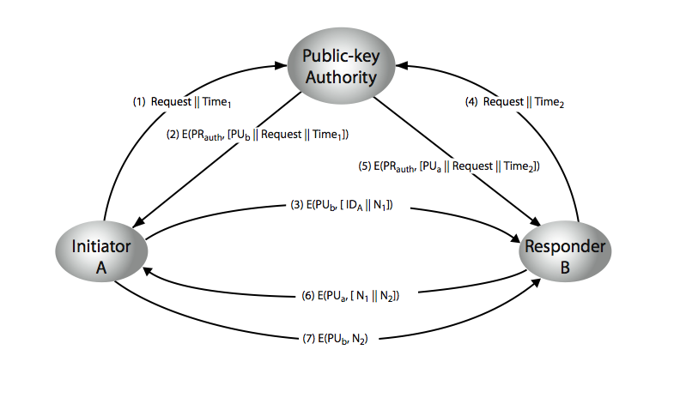
Public-Key Authority
Notes:
Stallings Figure 10.3 “Public-Key Authority” illustrates a typical protocol interaction. See text for details of steps in protocol.

Slide 7
Public-Key Certificates
certificates allow key exchange without real-time access to public-key authority
a certificate binds identity to public key
usually with other info such as period of validity, rights of use etc
with all contents signed by a trusted Public-Key or Certificate Authority (CA)
can be verified by anyone who knows the public-key authorities public-key
Notes:
An further improvement is to use certificates, which can be used to exchange keys without contacting a public-key authority, in a way that is as reliable as if the keys were obtained directly from a public-key authority. A certificate binds an identity to public key, with all contents signed by a trusted Public-Key or Certificate Authority (CA). This can be verified by anyone who knows the public-key authorities public-key.
One scheme has become universally accepted for formatting public-key certificates: the X.509 standard. X.509 certificates are used in most network security applications, including IP security, secure sockets layer (SSL), secure electronic transactions (SET), and S/MIME. Will discuss it in much more detail later.

Slide 8
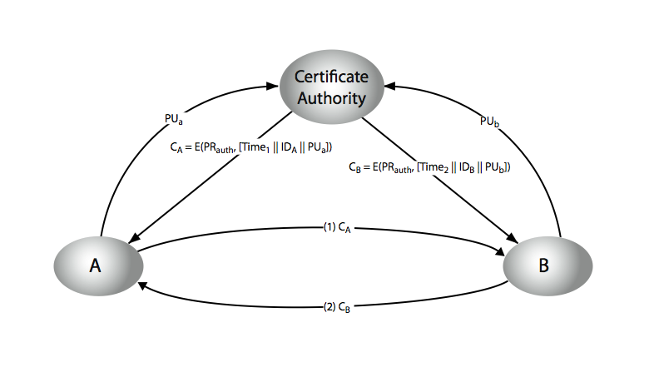
Public-Key Certificates
Notes:
Stallings Figure 10.4 “Public-Key Certificates” illustrates such a scheme. See text for details of steps in protocol.

Slide 9
Public-Key Distribution of Secret Keys
use previous methods to obtain public-key
can use for secrecy or authentication
but public-key algorithms are slow
so usually want to use private-key encryption to protect message contents
hence need a session key
have several alternatives for negotiating a suitable session
Notes:
Once public keys have been distributed or have become accessible, secure communication that thwarts eavesdropping, tampering, or both, is possible. However, few users will wish to make exclusive use of public-key encryption for communication because of the relatively slow data rates that can be achieved. Accordingly, public-key encryption provides for the distribution of secret keys to be used for conventional encryption.

Slide 10
Simple Secret Key Distribution
proposed by Merkle in 1979
A generates a new temporary public key pair
A sends B the public key and their identity
B generates a session key K sends it to A encrypted using the supplied public key
A decrypts the session key and both use
problem is that an opponent can intercept and impersonate both halves of protocol
Notes:
An extremely simple scheme was put forward by Merkle [MERK79]. But it is insecure against an adversary who can intercept messages and then either relay the intercepted message or substitute another message. Such an attack is known as a man-in-the-middle attack [RIVE84].

Slide 11
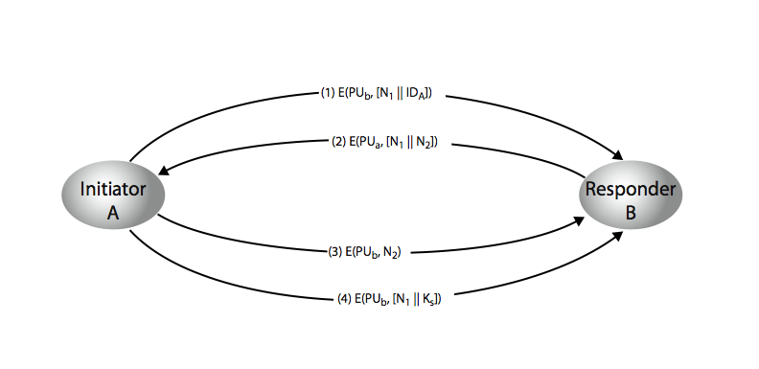
Public-Key Distribution of Secret Keys
if have securely exchanged public-keys:
Notes:
Stallings Figure 10.6 “Public-Key Distribution of Secret Keys” illustrates such an exchange. See text for details of steps in protocol. Note that these steps correspond to final 3 of Figure 10.3, hence can get both secret key exchange and authentication in a single protocol.

